Slide 1

Data Structures and Algorithms: Maximum Flow
Notes, Chapter 26, CLRS

Slide 2
Problem
We want to get “stuff” from one or more places (sources) to one or more other places (sinks). How much stuff can we transport?
Obvious applications
Data packets over networks
Logistics
Less obvious applications
Matchings

Slide 3
Overview
Flow Networks
Max-flow Min-cut Theorem
Ford-Fulkerson Method
Edmonds-Karp Algorithm
Bipartite Matching

Slide 4
Flow Networks
A directed graph G = (V,E) is a flow network if each edge (u,v)∈E has a non-negative capacity c(u,v).
Each edge has flow f(u,v)
If there is no edge (u,v)∈E, c(u,v) = 0.
If we have both edges (u,v) and (v,u), at most one can have (positive) flow.
For our purposes, the “stuff” is undifferentiated, so it doesn’t make sense to have flow going in both directions.

Slide 5
Flow Properties
Flow in the entire network goes from a source s to a sink t.
This will be relaxed later WLOG (without loss of generality).
Flow may go into the source and/or out of the sink.
Flow conservation: ∀u ∈ V-{s,t}, Σ_{v∈V} f(v,u) = Σ_{v∈V} f(u,v)
Flow into u = flow out of u.
Edge Flow vs. Capacity: ∀ u,v ∈ V, 0 ≤ f(u,v) ≤ c(u,v)

Slide 6
Flow Properties
Total flow in network |f| = Σ_{v∈V} f(s,v) - Σ_{v∈V} f(v,s)
Maximum Flow Problem: Find the maximum flow from source to sink in the network.

Slide 7
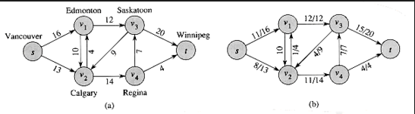
Notation
Capacity on the left, flow/capacity on the right
“10” on right means “0/10”

Slide 8
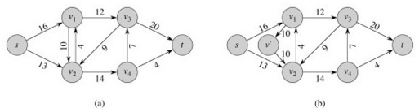
Anti-parallel Edges
The algorithms assume that there are no bi-directional links between the same pair of nodes.
Deal with an anti-parallel edge by creating a new pseudo-node
And move one edge to go through that pseudo-node.

Slide 9
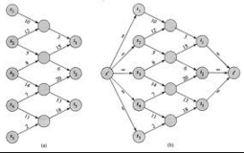
Multiple Sources and/or Sinks
Deal with Multiple Sources and/or Sinks by creating a “supersource” and/or “supersink”

Slide 10
Residual Network
The residual network G_{f} in a graph G is the network of unused capacity.
Note that the residual network can have flows in both directions.
Unlike the standard network.
Residual capacity from u → v is:
Remember, you can’t have bi-directional flows.

Slide 11
Augmenting Path
A flow that adds to the total flow in the network by making use of unused capacity from s to t is an augmenting path.

Slide 12
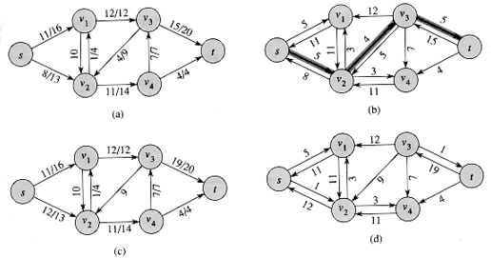
Example: Residual Network with Augmenting Path
Flow network
Residual network of (a)
With augmenting path of value 4
New flow network
Residual network of (c)

Slide 13
Ford-Fulkerson Method
It’s a method because it needs more detail to become an algorithm.
initialize f = 0
Compute residual network G_{f}
while (∃ augmenting path p in residual network G_{f})
augment flow f along p
recompute G_{f}
return f
The trick is to find the augmenting paths systematically.

Slide 14
Net flow across a cut
A cut of a flow network in graph G = (V,E) is a partition of V into sets S and T=V-S with s∈S and t∈T
The net flow across the cut is given by

Slide 15
Capacity of a cut
The capacity of the cut is given by
Note that the capacity of the cut only counts the edges going from S to T.
The minimum cut is the cut whose capacity is minimum over all cuts of the network.

Slide 16
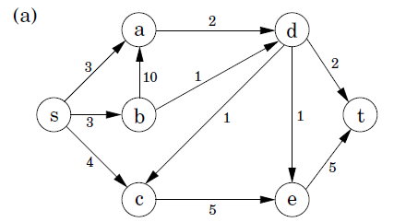
Max-Flow, Min-Cut Theorem
If f is a flow in a flow network G=(V,E) with source s and sink t, then the following are equivalent conditions:
f is the maximum flow in G
The residual network G_{f} contains no augmenting paths.
|f| = c(S,T) for some cut (S,T) in G
In other words, the max flow = min cut

Slide 17
Max-Flow, Min-cut Theorem: hand-waving
Clearly the max flow can’t be greater than the min cut (you can’t put any more flow across).
Suppose that the max flow is less than the min cut. This is the min cut, so if you increase the flow across this cut, you can increase the flow equally or more across every other cut.
For simplicity, we assume the min cut is unique.
Increase the flow to the value of the min cut, and you’ve successfully increased the flow from s to t.

